Slide 1
Analyzing Burlington’s Dog Community
Zoey Zhong
Team 17
#Research Question:
How do the characteristics of registered dogs in Burlington, Vermont (such as breed, size, color, and age) reflect the preferences and demographics of the city's dog-owning population?

Slide 2
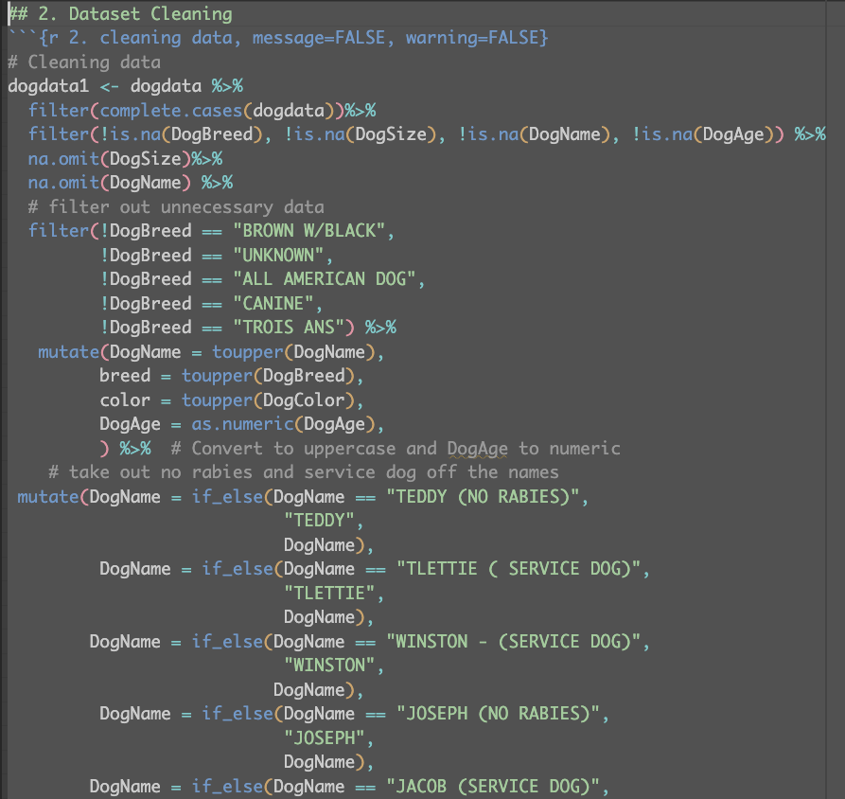
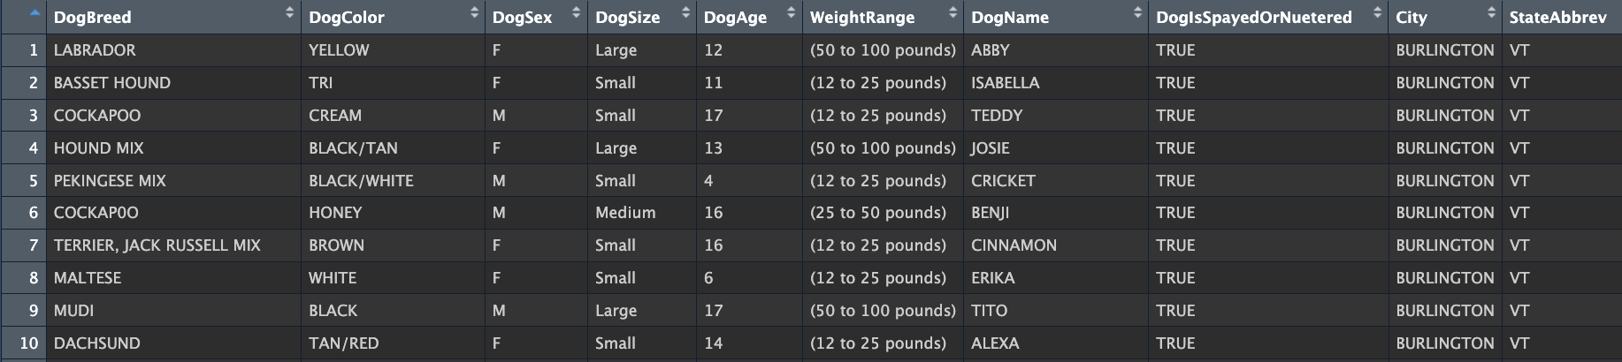
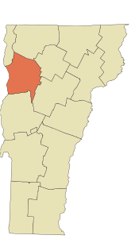
Overview of the Dataset
This analysis focuses on a dataset of registered dogs in Burlington, Vermont, as of April 30, 2022, covering various aspects such as breed, color, age, size, and more for 794 dogs. The data, published by Burlington's Clerk Treasurer's Office, represents registered dogs but may not fully capture the city's entire dog population due to registration costs and exclusion of strays.
Notes:
Variables Description
Below is a brief description of the features included in the dataset:
*DogBreed*: Breed of the dog.
*DogColor*: Color of the dog.
*DogSex*: Sex of the dog (Male/Female).
*DogSize*: Size category of the dog (Small/Medium/Large).
*DogAge*: Age of the dog in years.
*WeightRange*: Weight range of the dog.
*DogName*: Name of the dog.
*DogIsSpayedOrNuetered*: Indicates whether the dog is spayed or neutered (True/False).
*City*: City where the dog is registered.
*StateAbbrev*: State abbreviation where the dog is registered.

Slide 3
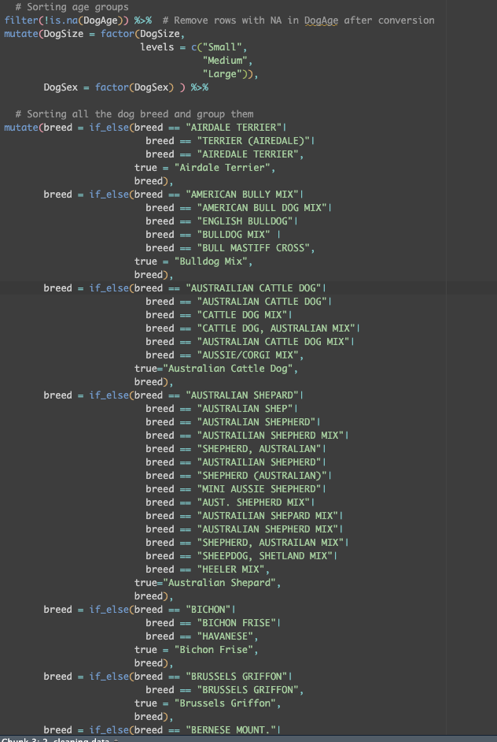
Data Cleaning and Standardization
01
04
02
05
03
06
Filtering Incomplete Records
Reclassifying Dog Breeds
* Removed rows with missing values in critical fields (DogBreed, DogSize, DogName, DogAge)
* Excluded nonspecific or ambiguous breed names like "UNKNOWN", "ALL AMERICAN DOG", etc..
* Consolidated various spellings and similar breeds into standard breed names.
* Reduced the number of unique breed categories by grouping similar breeds.
Standardizing Textual Data
Handling Dog Colors
* Converted DogName, DogBreed, and DogColor to uppercase for uniformity.
* Transformed DogAge to a numeric format for easier analysis.
* Standardized color names, grouping similar shades and patterns together.
* Simplified the color classification by combining variations of the same color.
Refining Dog Names
* Removed specific annotations like "(NO RABIES)" and "(SERVICE DOG)" from dog names for consistency.
Categorizing Dog Sizes
and Sex
* Converted DogSize and DogSex into factor variables for easier categorization and analysis.

Slide 4
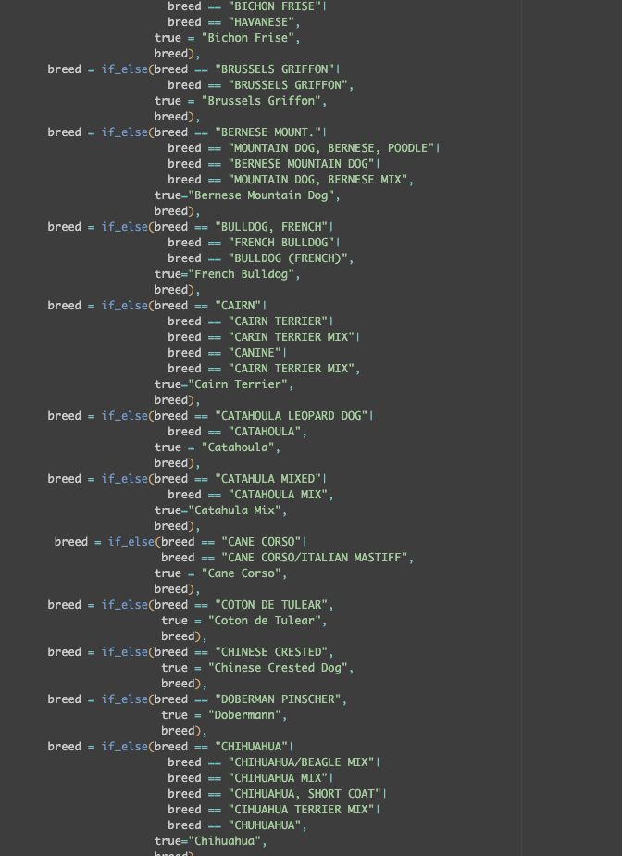
Data Cleaning and Standardization
01
04
02
05
03
06
Filtering Incomplete Records
Reclassifying Dog Breeds
* Removed rows with missing values in critical fields (DogBreed, DogSize, DogName, DogAge)
* Excluded nonspecific or ambiguous breed names like "UNKNOWN", "ALL AMERICAN DOG", etc..
* Consolidated various spellings and similar breeds into standard breed names
Standardizing Textual Data
Handling Dog Colors
* Converted DogName, DogBreed, and DogColor to uppercase for uniformity.
* Transformed DogAge to a numeric format for easier analysis.
* Standardized color names, grouping similar shades and patterns together.
* Simplified the color classification by combining variations of the same color.
Categorizing Dog Sizes
and Sex
* Converted DogSize and DogSex into factor variables for easier categorization and analysis.
Notes:
The dataset initially presented significant challenges due to its complexity and inconsistency in data entries. With over 20 variations for a single breed like the Labrador Retriever Mix and more than 30 different descriptors for a brown dog color, the dataset required extensive cleaning and standardization. This effort streamlined the breed count from 789 to 62 made the information more clear and manageable.

Slide 5
Top 10 Most Common Breeds in Burlington
Breed | Count
Labrador Retriever | 54
Mixed Breed | 53
Labrador Retriever Mix | 44
Golden Retriever | 38
Terrier | 33
Hound Mix | 25
German Shepherd Mix | 21
Pitbull Mix | 21
Spaniel | 19
Australian Shepard | 16
Notes:
In Burlington, Vermont, the most common dog breeds among registered pets are Labrador Retrievers (54) and Mixed Breeds (53), followed by Labrador Retriever Mixes (44). Other prevalent breeds include Golden Retrievers, Terriers, and Hound Mixes. This data reflects the diversity of the dog population in Burlington, with a notable preference for Labrador Retrievers and mixed-breed dogs.

Slide 6
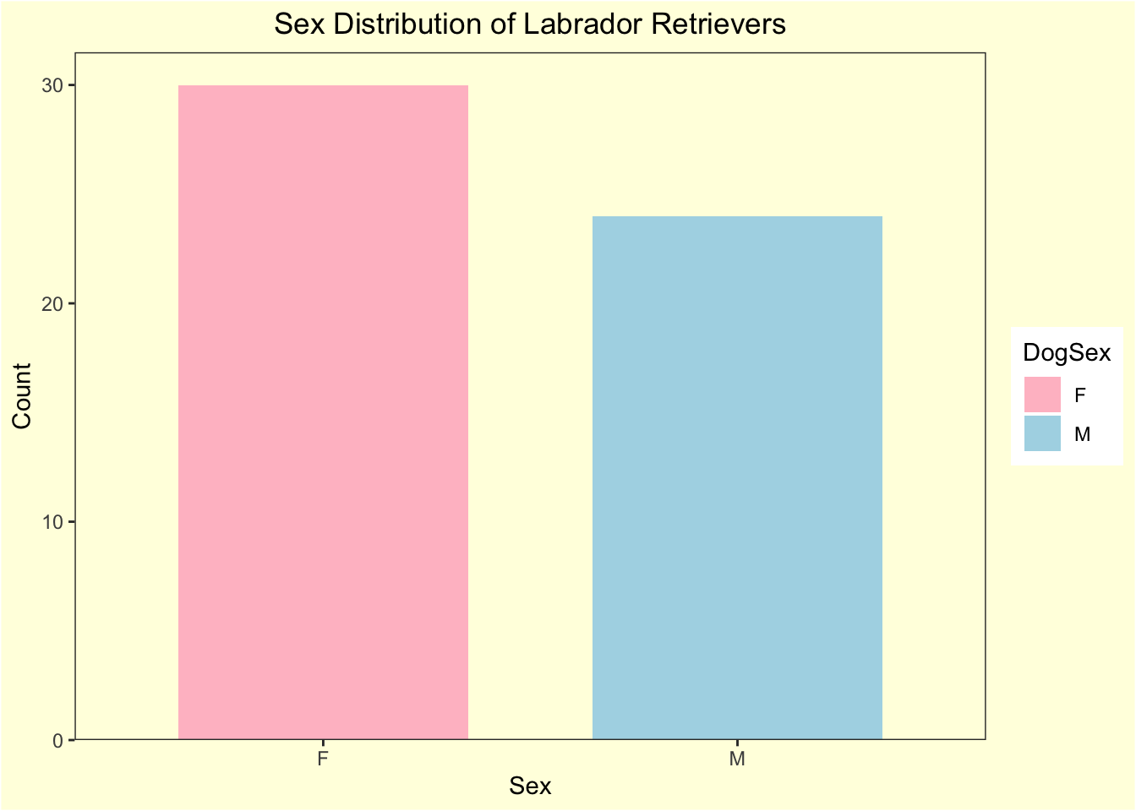
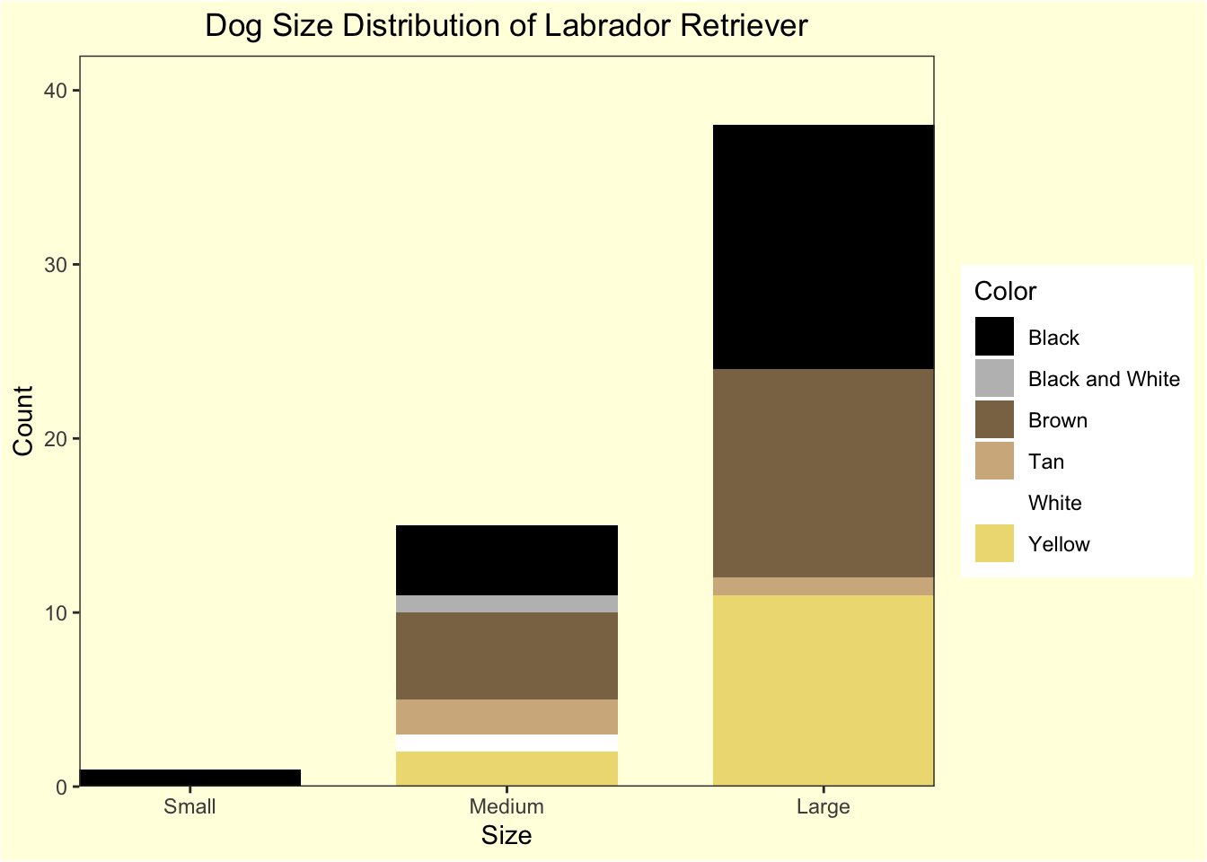
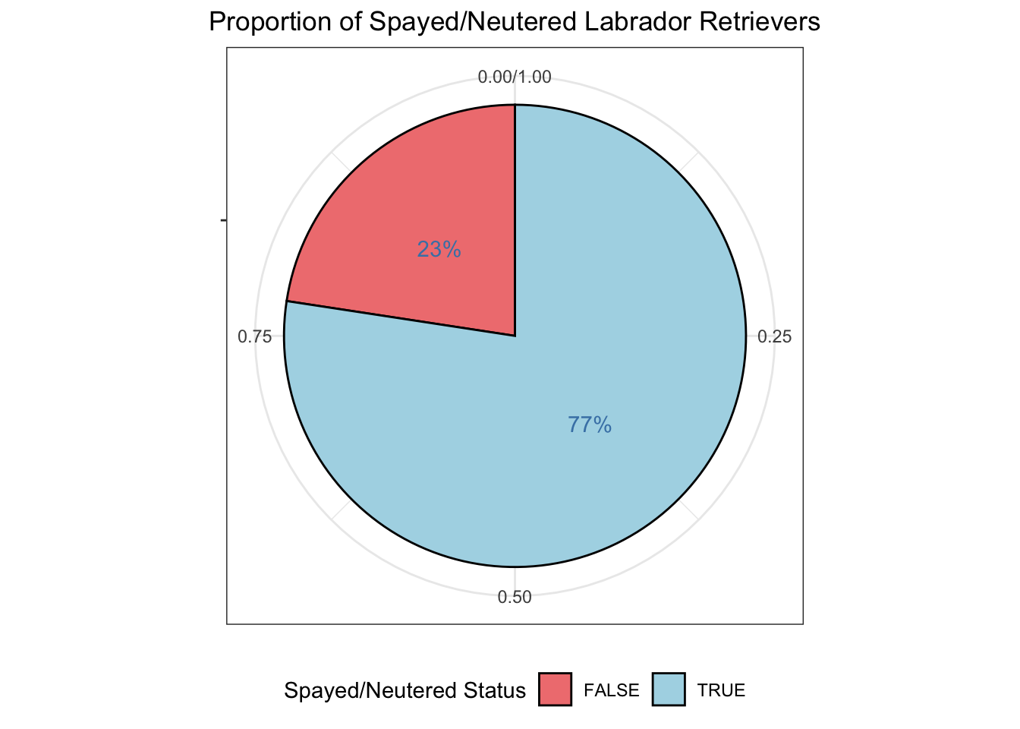
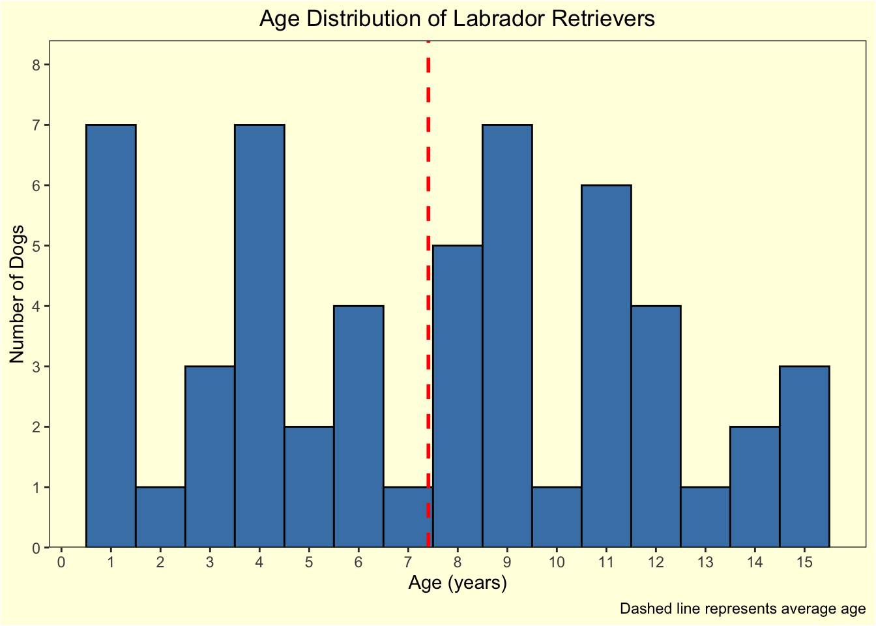
Labrador Retrievers Focus
Size Distribution
Sex Distribution
Age Distribution
Spayed/Neutered

Slide 7
Size Distribution
Sex Distribution
Age Distribution
Spayed/Neutered
Notes:
Size and Color Distribution of Labrador Retrievers: The distribution is heavily skewed towards larger-sized Labrador Retrievers, which is characteristic of the breed. Black Labs dominate the population, with brown as the second most common color. This suggests a preference for the traditional Labrador colors in Burlington, with other colors like tan, white, and black and white being less common.
Age Distribution of Labrador Retrievers: The histogram illustrates that Labrador Retrievers are most frequently aged 1, 4, and 9 years, with a notable presence of dogs at 11 years old. There's a decrease in frequency as age increases, with the lowest number of dogs at age 5 and a slight increase again at age 15. The average age, marked by the dashed line in the histogram, indicates a mid-range age that is not the most common but suggests a balance across the sampled ages
Sex Distribution of Labrador Retrievers: The nearly even split between male and female dogs suggests that there is no strong preference for a particular sex among Labrador Retriever owners in Burlington. This balance could be beneficial for maintaining a stable breeding population.
The pie chart indicates that 77% of Labrador Retrievers in the dataset have been spayed or neutered, with only 23% remaining. This suggests strong responsible pet ownership practices in terms of population control and animal welfare in the community.

Slide 8
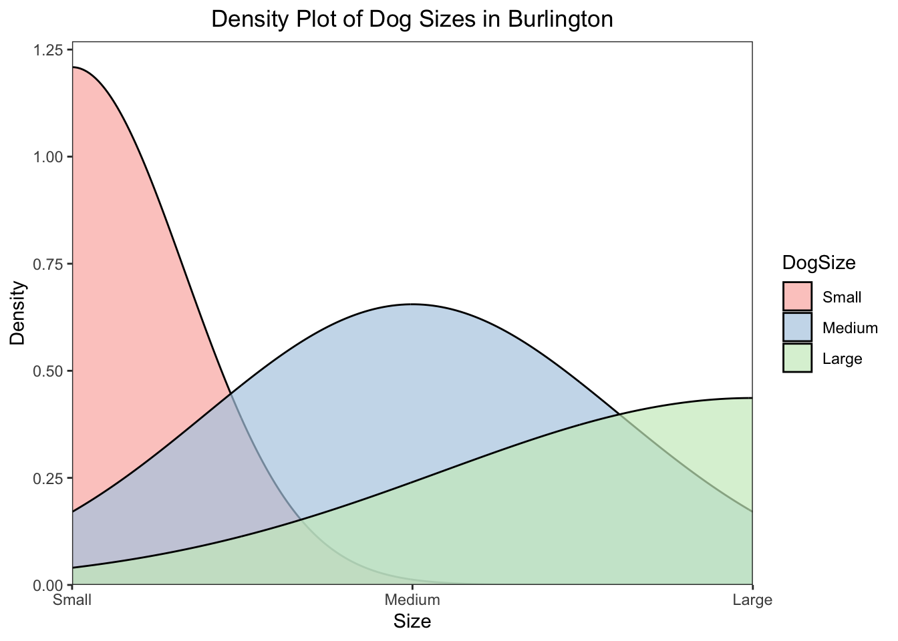
Most popular size and color dogs in Burlington

Slide 9
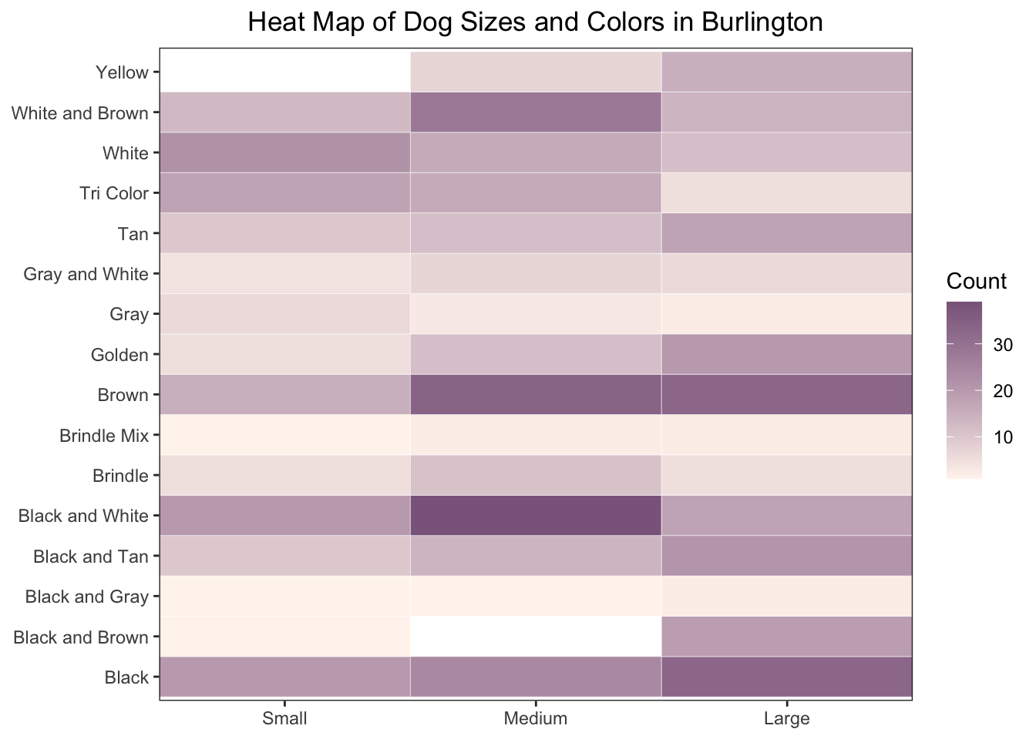
Most popular size and color dogs in Burlington
Notes:
Size and Color Correlation of Dogs in Burlington: The density plot indicates a preference for medium-sized dogs in Burlington, which is the most common size category. The heat map further illustrates this tendency, with certain colors like brown, black& white, black appearing more frequently within this size category. The color trends show that some colors are notably more prevalent in medium-sized dogs, reflecting a possible correlation between dog size and color preferences in the city.

Slide 10
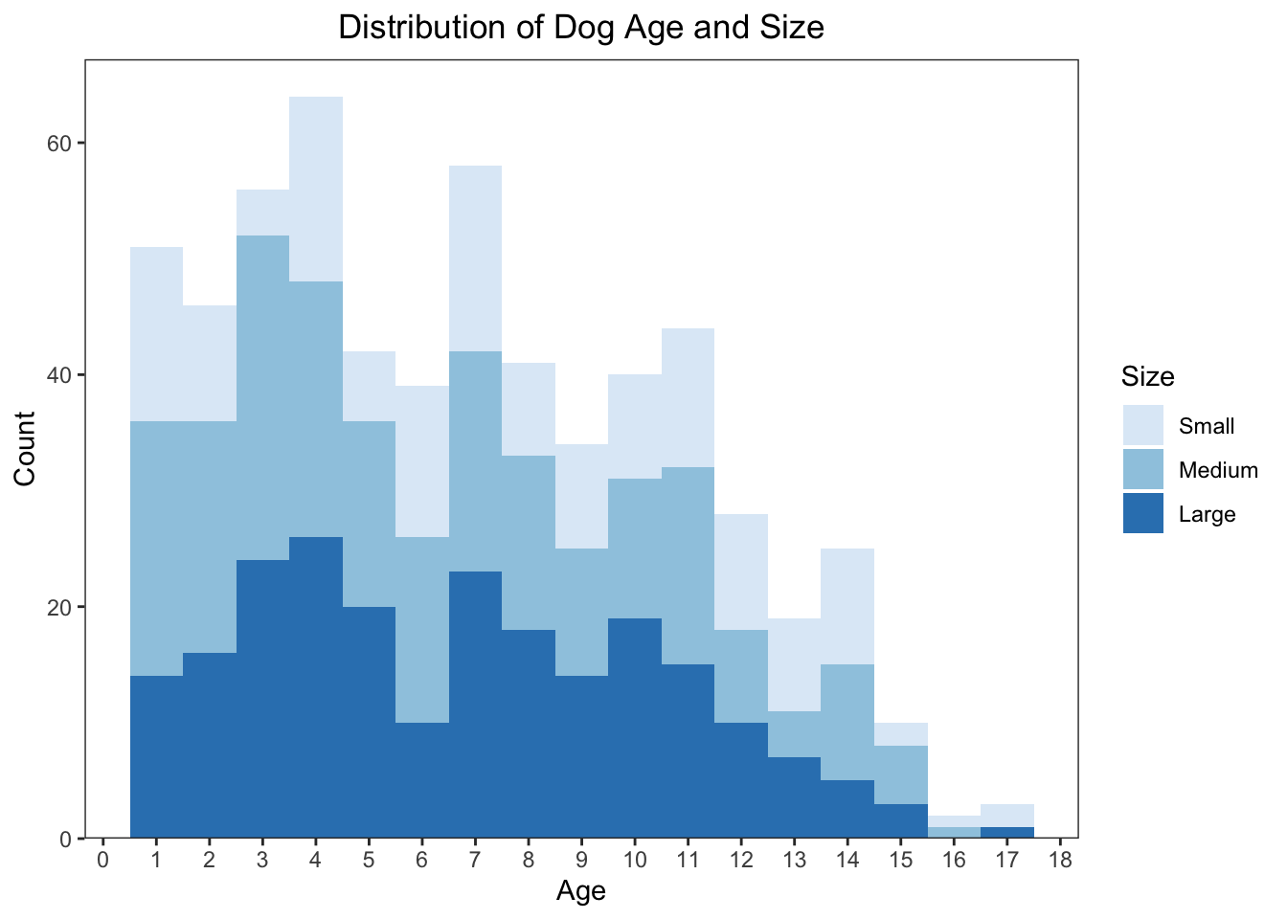
THE RELATIONSHIP BETWEEN DOG SIZE AND THEIR AGE
Notes:
Based on the distribution of the histogram: The histogram shows us that younger dogs, especially puppies, are more common in Burlington, hinting that people might prefer to adopt younger dogs. Also, as dogs get older, we see more small-sized dogs than larger ones, which could point to longer lifespans for smaller dogs or a sustained preference for them in older age groups.

Slide 11
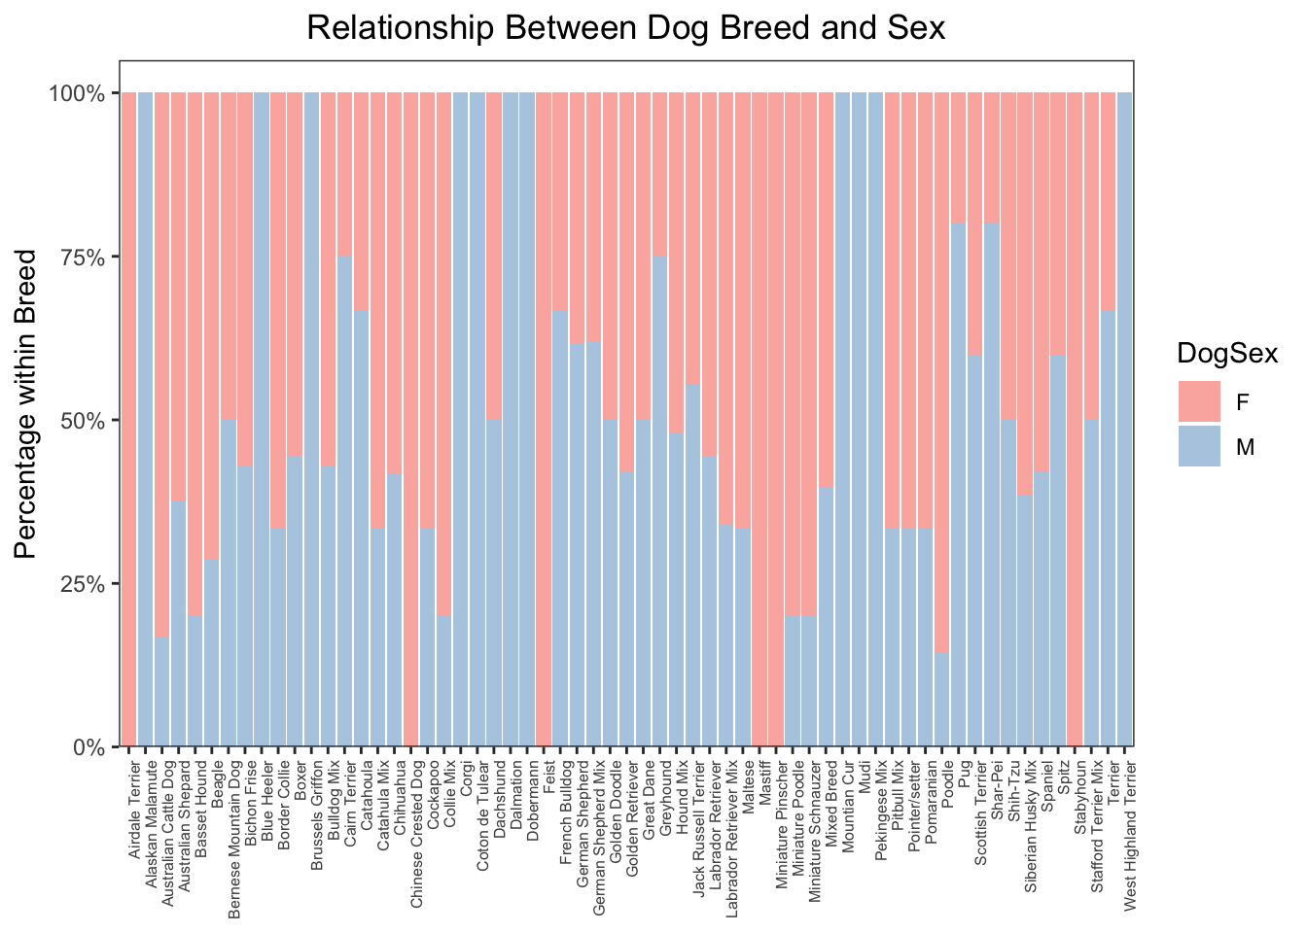
The Relationship Between Dog Sex And Breed
Notes:
The intent of the analysis was to uncover potential correlations between the size of a dog and its breed. However, the resulting visualization did not yield the expected insights due to a significant number of breeds being underrepresented in the dataset—most having fewer than five instances. This low representation can lead to skewed results, as the data might not accurately reflect the broader population of these breeds. Consequently, it becomes challenging to draw any reliable conclusions about the relationship between breed and size from this graph alone. For future analysis, it would be beneficial to obtain a more balanced dataset where rare breeds are more adequately represented.

Slide 12
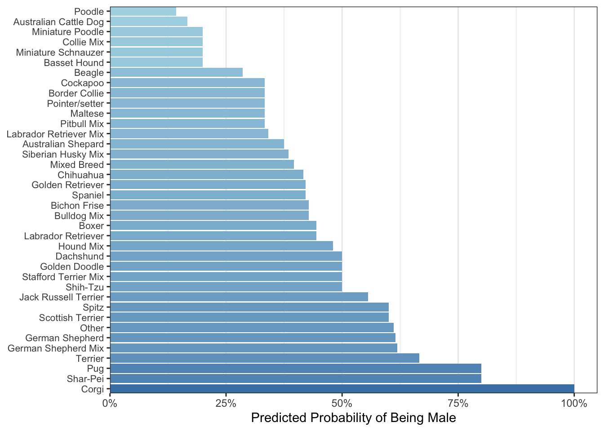
Predicting The Probability Of Being Male
Notes:
The analysis of this graph focused on predicting the likelihood of a dog being male across different breeds, with a particular emphasis on enhancing the dataset’s balance. Rare breeds, initially causing skewed insights due to their low occurrence, were consolidated into an “Other” category. This adjustment led to a more meaningful interpretation of the data, allowing for a clearer differentiation between common and rare breeds. The visualization now effectively illustrates the predicted male probability per breed, with the logistic regression model’s output facilitating a more accurate representation of the dataset. The bar chart, with its color gradient, highlights the variance in male probability across breeds, offering a visual summary that underpins potential breed-specific trends. While this approach yields more reliable insights, it is still limited by the dataset’s inherent biases and the representativeness of the “Other” category. Future analyses would benefit from a dataset with a more equitable distribution of breed occurrences to validate these findings further.
Based on the graph Breeds at the top, like Poodles and Australian Cattle Dogs, have a lower predicted probability of being male, whereas those at the bottom, like Corgis and Shar-Peis, have a higher probability.

Slide 13
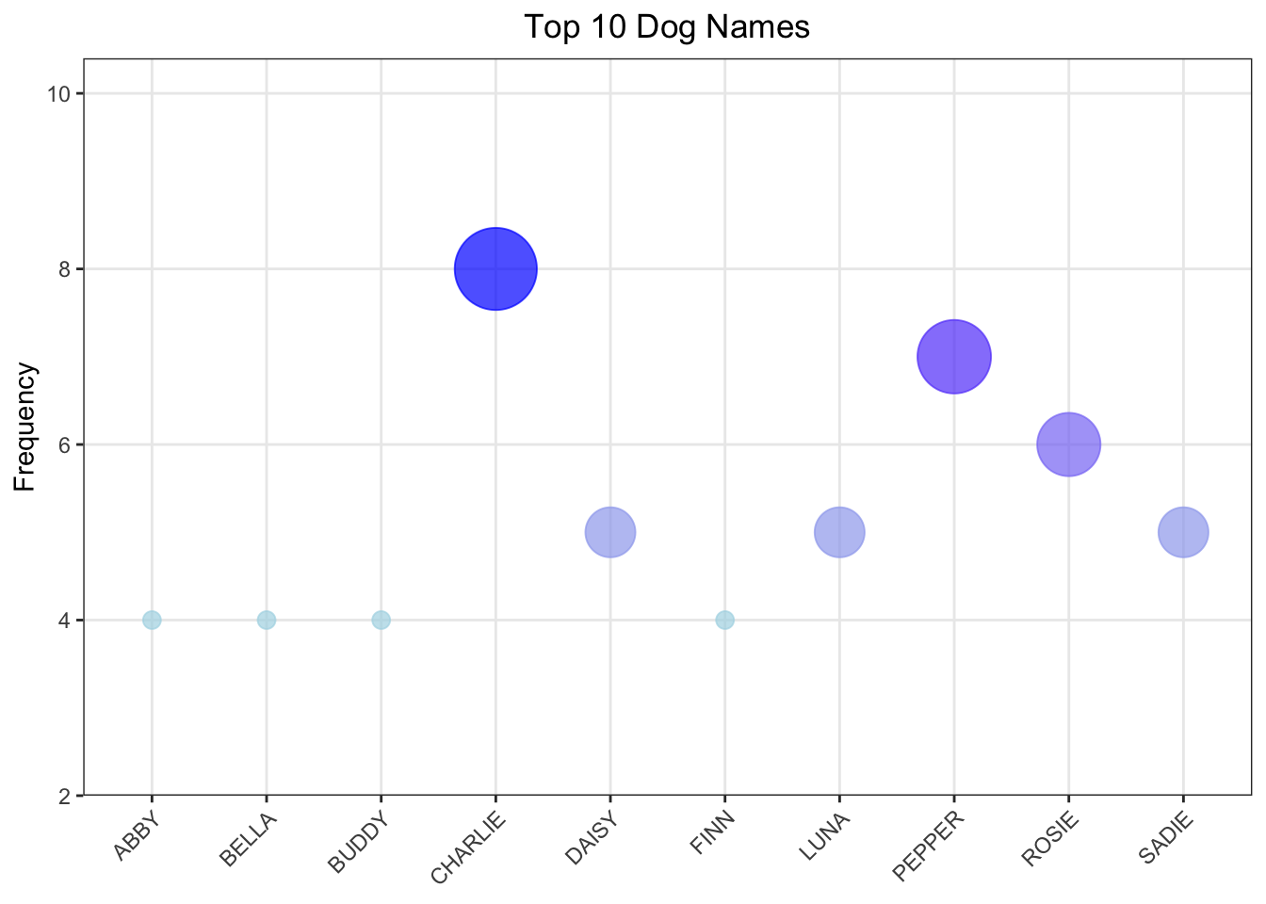
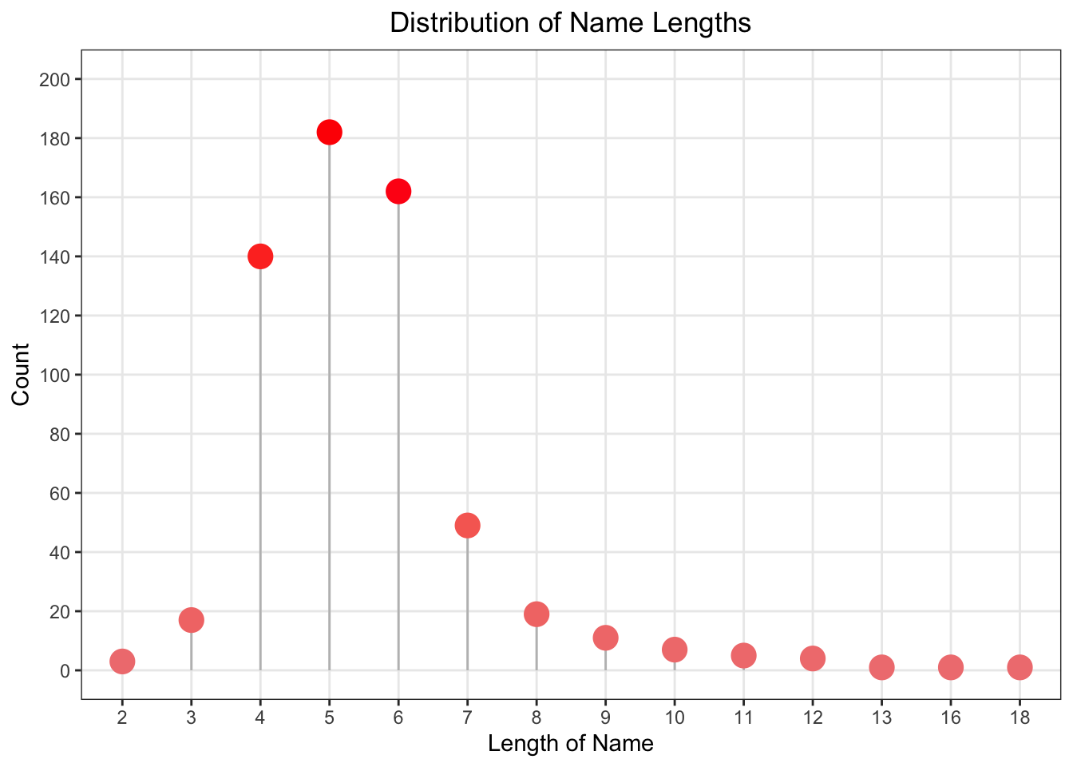
Dog Name Trends
Notes:
Top 10 Dog Names Bubble Chart: This chart showcases the most popular dog names in the dataset. Each bubble represents a name, and the size of the bubble corresponds to how frequently the name occurs. The largest bubble is notably larger than the others, indicating that one name is particularly common among the dogs. The names are spread out horizontally and alphabetical
Distribution of Name Lengths Lollipop Chart: This chart shows the frequency of different name lengths. Each “lollipop” represents a specific length of name, and the size of the circle at the end of the “lollipop” indicates the count of names of that length. There’s a clear peak at length between 4-6 characters, suggesting that most of the dog names have this length. The counts decrease for longer and shorter names, indicating a preference for names within a moderate length.

Slide 14
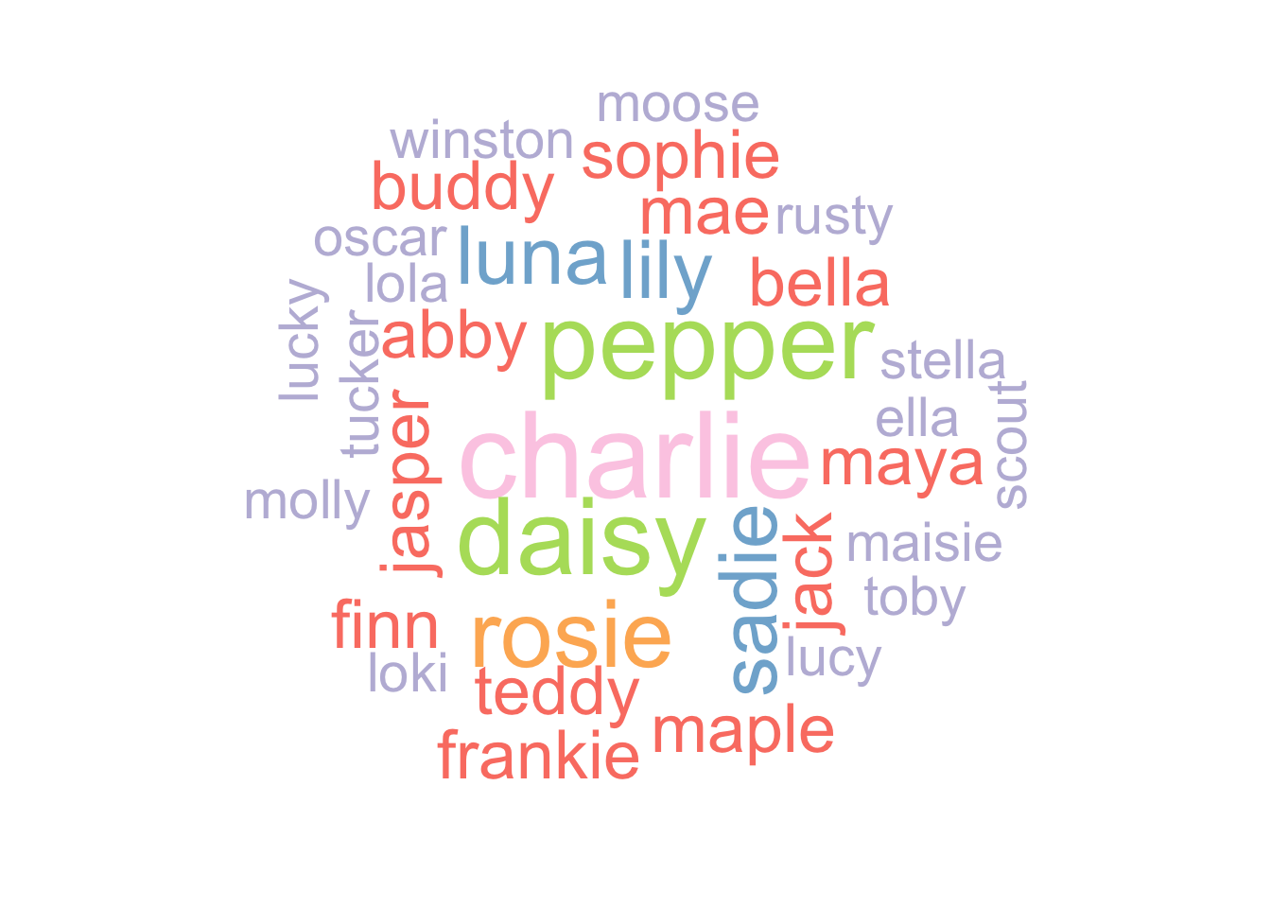
Notes:
Word Cloud: The word cloud visualizes the frequency of sample part if dog names, with the size of each word reflecting its relative frequency. The largest words in the center (“Charlie”, “Bella”, “Luna”, “Daisy”, and “Rosie”) are presumably the most common names. The distribution of sizes gives a quick visual impression of the variety and popularity of names.

Slide 15
Summary
Original Hypothesis:
Smaller Breeds Preference: Residents of Burlington may prefer smaller dog breeds due to the city's living spaces and lifestyle.
Medium-sized dogs are prevalent, with a balanced age and sex distribution indicating no significant bias.
Breed and Recreation Connection: The popularity of certain dog breeds in Burlington may be linked to the recreational activities available in the city, such as hiking or water sports.
- Labrador Retrievers are considered the best hiking dog breed.
Limitations of the Project Based on the Available Variables
Data Completeness and Accuracy
Inconsistent Data integrity
Limited qualitative data analysis
Breed Specific Analysis
Notes:
Data Completeness and Accuracy:
The dataset might not include all Burlington's dogs since not all dogs are registered, possibly due to cost or because they are strays.
The accuracy of data is dependent on the dog owners' input at registration. Mistakes or variations in how dog breeds or colors are reported can introduce inconsistencies.
Inconsistent Data integrity
accuracy and consistency of data throughout was very random like some of them are capitalized some are not and misspelling Limited qualitative data analysis The limitation in my project due to limited qualitative data is significant because it narrows the scope of my analysis. I only have one numerical variable to work with, which limits the types of statistical techniques I can use. Also, having two variables that are nearly identical doesn't help; it just means I'm using up valuable data space without adding new insights.
Breed Specific Analysis:
The breed information may be too generic or too specific in some cases, making it difficult to group breeds for analysis without subjective interpretation.
Some breeds may be underrepresented, leading to potential biases in breed-specific conclusions.

Slide 16
Thank You!

